Slide 1
Dimensionality Reduction

Slide 2
Curse of Dimensionality
As the number of features increases, the possible combination of values increases drastically.
An ideal dataset should capture all variations in each dimension for a predictor to perform well.
But this is seldom the case since we deal with a fixed size of training data. This phenomenon is known as Curse of Dimensionality.
There are techniques to overcome this. But if all else fails, obtaining more data is the only way to improve performance.

Slide 3
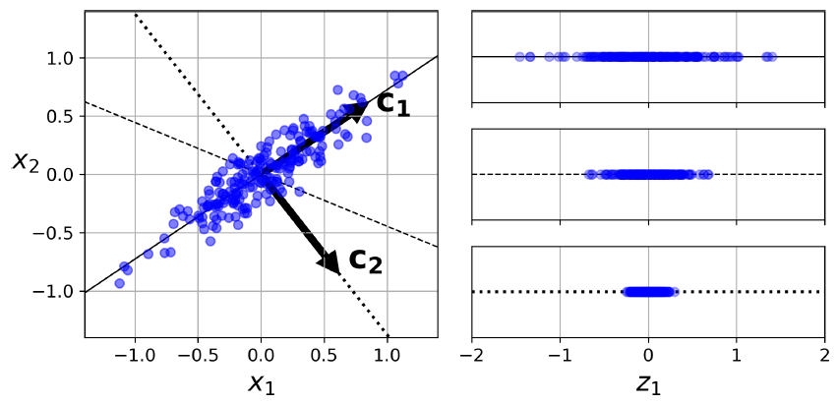




Principal Component Analysis
The idea is to project the data from a higher dimension d to equal or lower dimension k
The data is transformed into a subspace such that the variances are preserved.
The transformation is such that the variances are the highest in the new subspace where the axes are orthogonal.
Here, c1 and c2 are the principal components.

Slide 4
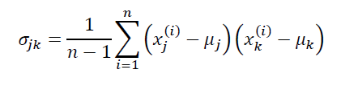
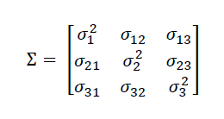
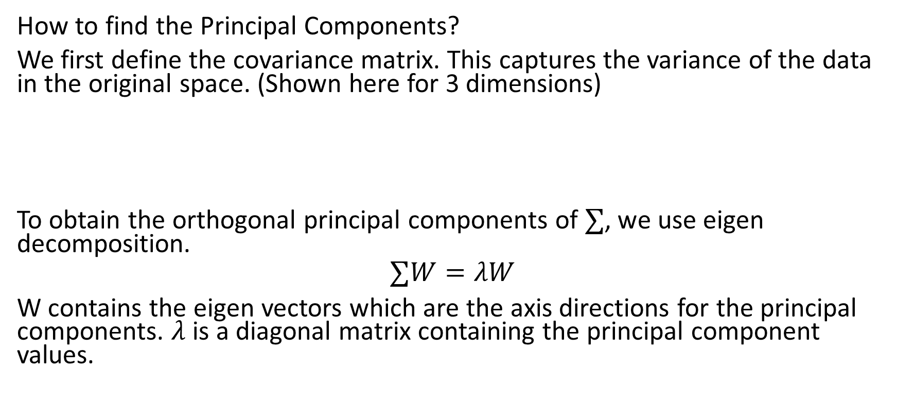
Principal Component Analysis
How to find the Principal Components?
We first define the covariance matrix. This captures the variance of the data in the original space. (Shown here for 3 dimensions)
To obtain the orthogonal principal components of $∑$, we use eigen decomposition.
$$∑W=λW$$
W contains the eigen vectors which are the axis directions for the principal components. $λ$ is a diagonal matrix containing the principal component values.

Slide 5
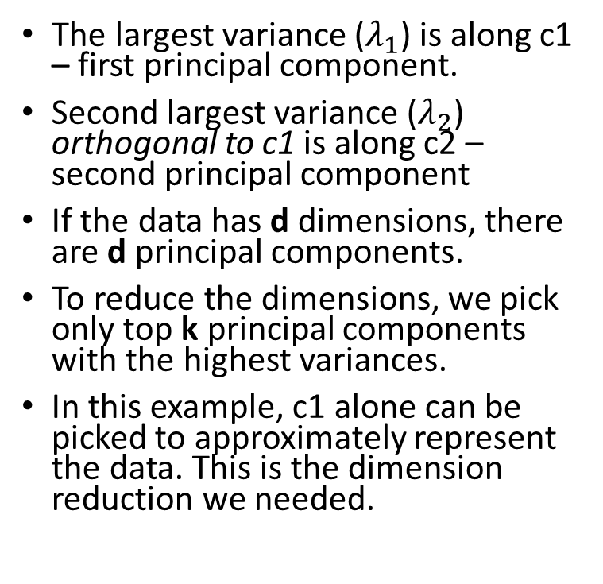
Principal Component Analysis
The largest variance ($λ_{1}$) is along c1 – first principal component.
Second largest variance ($λ_{2}$) orthogonal to c1 is along c2 – second principal component
If the data has d dimensions, there are d principal components.
To reduce the dimensions, we pick only top k principal components with the highest variances.
In this example, c1 alone can be picked to approximately represent the data. This is the dimension reduction we needed.

Slide 6
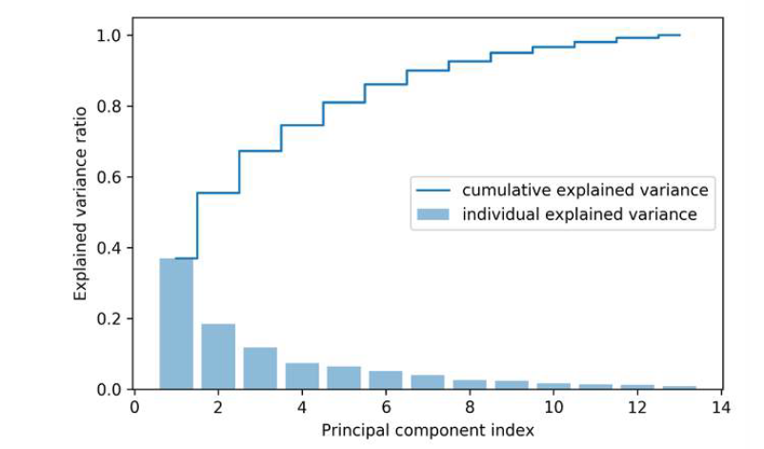
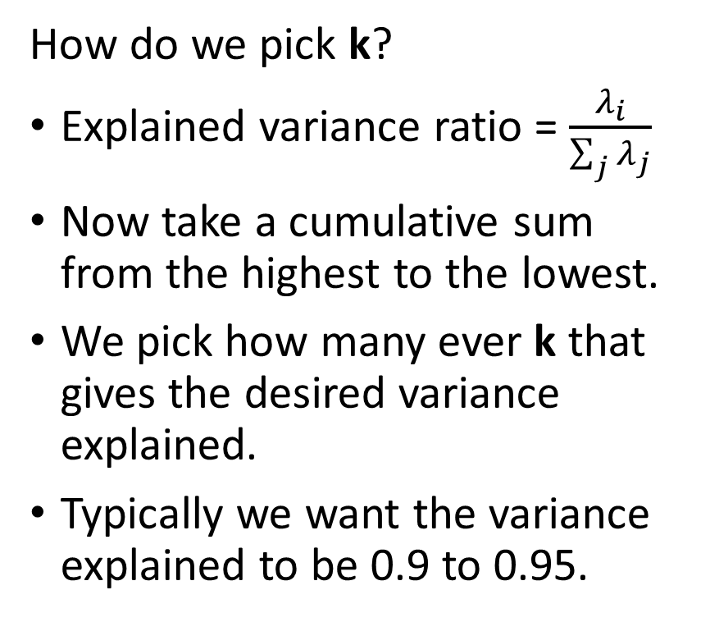
Principal Component Analysis
How do we pick k?
Explained variance ratio = $\frac{λ_{i}}{\sum_{j}{λ_{j}}}$
Now take a cumulative sum from the highest to the lowest.
We pick how many ever k that gives the desired variance explained.
Typically we want the variance explained to be 0.9 to 0.95.

Slide 7
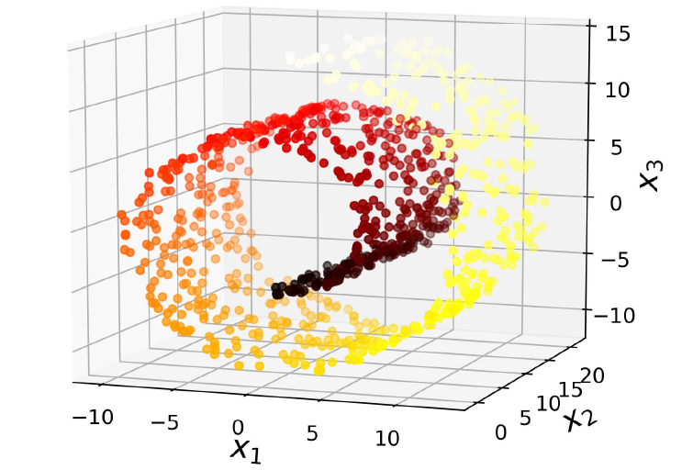
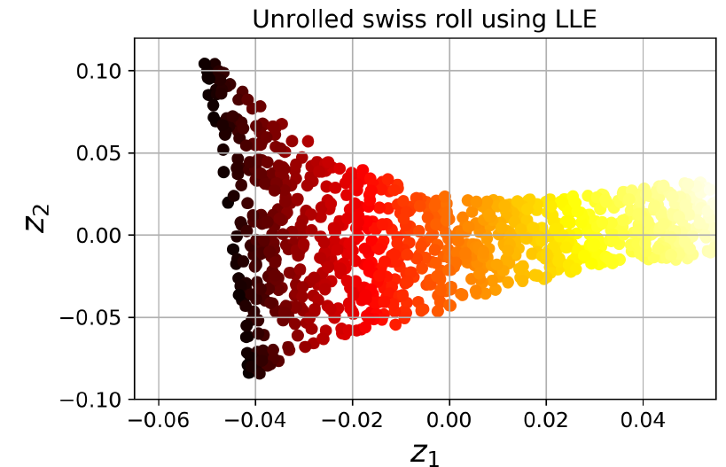
Manifold Learning
Swiss Roll data is a 2D manifold bent and twisted in a higher dimension. Dimensionality reduction methods that assume a manifold structure to the data falls under manifold learning
Swiss Roll Data

Slide 8

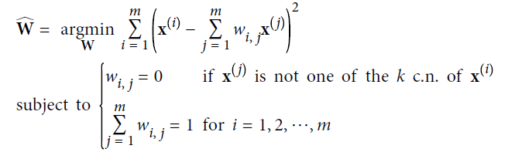
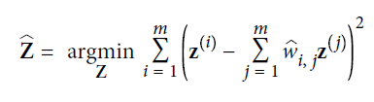
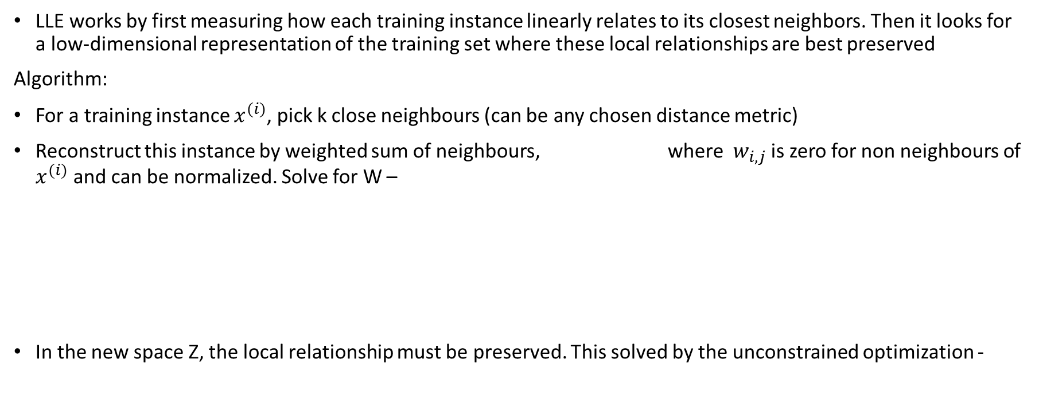
Local Linear Embedding
LLE works by first measuring how each training instance linearly relates to its closest neighbors. Then it looks for a low-dimensional representation of the training set where these local relationships are best preserved
Algorithm:
For a training instance $x^{(i)}$, pick k close neighbours (can be any chosen distance metric)
Reconstruct this instance by weighted sum of neighbours, where $w_{i,j}$ is zero for non neighbours of $x^{(i)}$ and can be normalized. Solve for W –
In the new space Z, the local relationship must be preserved. This solved by the unconstrained optimization -

